Slide 1

Notes:
Gui

Slide 2
Robotics Intensive: Rideable Hexapod
Gui Cavalcanti, Dan Cody, James Whong
4/17/2012
Notes:
Gui

Slide 3
Presentation Overview
Wait, what is this place?
Who are these guys?
Oh God, what have I signed up for?
What are we building?
How on earth are we building it?
Notes:
Gui

Slide 4
What is this place?
Notes:
Gui

Slide 5
What is this place?
Artisan’s Asylum, Inc.
Nonprofit community workshop
31,000 square feet
Multiple craft areas
Welding, machining, metalworking, woodworking, electronics assembly, sewing, bicycle repair…
20-25 classes a month
Notes:
Gui

Slide 6
Who are these guys?
Notes:
Gui

Slide 7


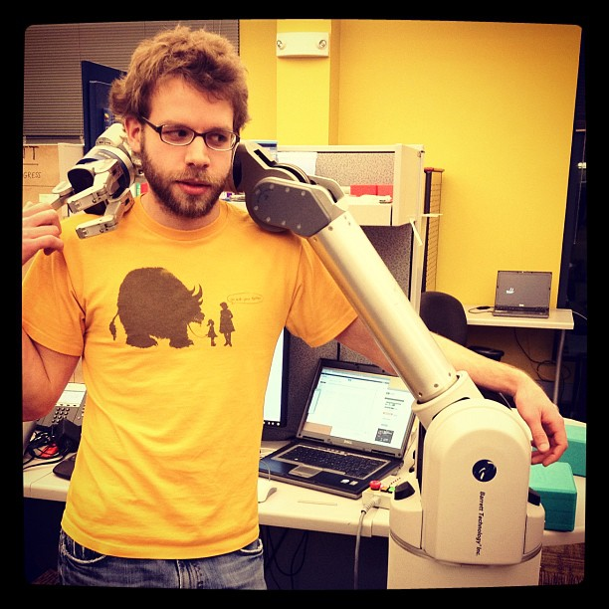
Who are these guys?
Gui Cavalcanti Dan Cody James Whong

Slide 8
Who are these guys?
Olin College of Engineering grads
Professional roboticists
Crazy motherfuckers

Slide 9
Gui Cavalcanti
Mechanical/Systems Engineer
Formerly systems integrator for a $35M, 1,200 pound hydraulic robot horse
Worked on BigDog, PETMAN, LS3 and more
Co-founder and President of Artisan’s Asylum
Makes giant rubber duckies, floating bouncy castles, and dragon sculptures for fun

Slide 10
Dan Cody
Controls/Electrical Engineer
Designer and author of libbarrett, open-source real-time controls library behind WAM arm
Worked on Barrett’s WAM arm, DEKA’s Luke arm, and more
Currently a controls engineer at Barrett Technologies
Dangles from cliff faces for fun

Slide 11
James Whong
Electrical/Controls Engineer
Designed distributed electrical control infrastructure for several Boston Dynamics robots
Worked on PETMAN, RCTA, ATLAS, and a number of robots for DEKA, Vision Robotics, and others
Currently an electrical engineer at Boston Dynamics
Hates fun
Notes:
Add video

Slide 12
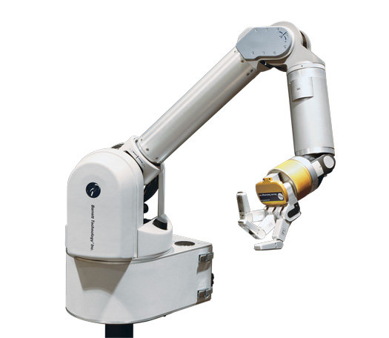
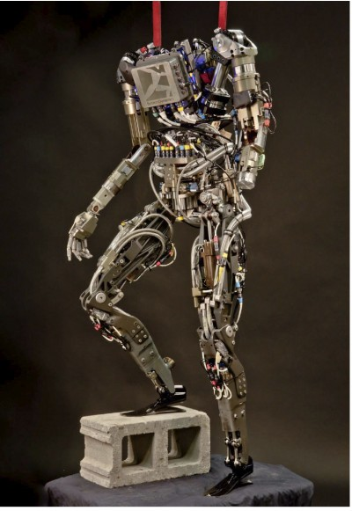
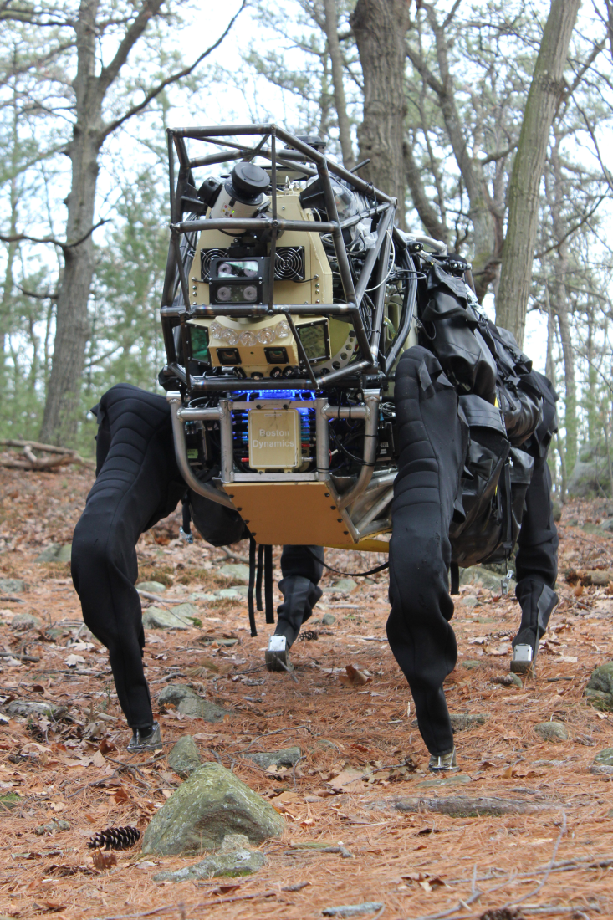
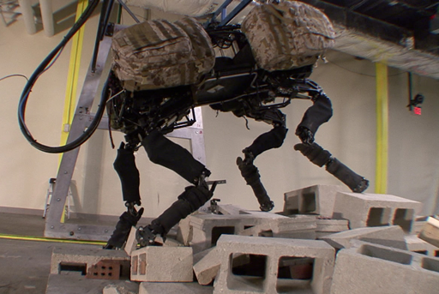
Projects We’ve Worked On

Slide 13
Our Roles
Instructors:
Teach you how to accomplish project goals
Create exercises to guide you through the design process
Critically evaluate and give feedback to your designs and ideas
Project Managers:
Keep the whole project moving and relatively on-schedule
Make high-level systems decisions and review low-level detail decisions
Find and allocate money, time, energy, etc. in the pursuit of ridiculousness
These will sometimes conflict, we need your help to resolve this

Slide 14
Who are you?

Slide 15
Who Are You?
What’s your name?
What’s your background?
Why do you like robots?
What are you hoping to get out of the class?

Slide 16
What have I signed up for?

Slide 17
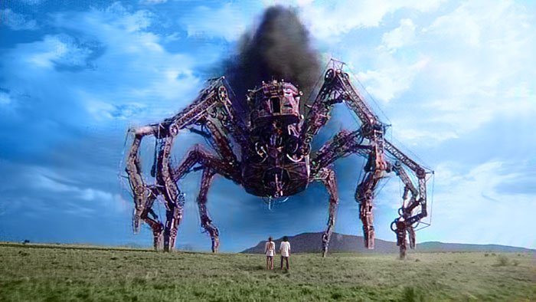
What you’ve signed up for.

Slide 18


A Grand Experiment
+
Public, project-based education

Slide 19
A Grand Experiment
Robots take a ton of the following:
Money
Time
Energy
Informed, correct decisions

Slide 20
A Grand Experiment
Classes provide
Income from tuition
Fixed, recurring, devoted time with a large group
Energy for learning and creating
Decision-making infrastructure

Slide 21
A Grand Experiment, Cont.
LS3: $1,500,000 in components, 120,000+ man-hours
PETMAN: $2,000,000 in components, 100,000+ man-hours
BigDog: $500,000 in components, 120,000+ man-hours
Rideable Hexapod: $10,000 in components, 3,000 man-hours

Slide 22
A Grand Experiment
Design a class to create a giant hexapod
Class income provides $10,000+
Fixed time slots demand recurring attention, large class has a ton of productive capacity
Students get to learn exactly how robots are designed, and practice doing the heavy lifting
Instructors/project managers get to guide a successful project to completion
Everybody wins!

Slide 23
What are we building?

Slide 24
What are we building?

Slide 25
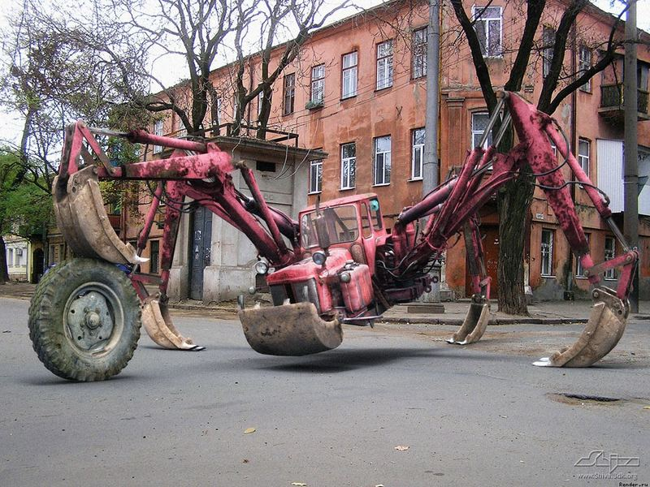
Actually, more like…

Slide 26
Design Goals
1-2 person payload
Inherently stable, “safe”
Walk at 3-4mph
Run for an hour at a time
Make people go “wow”

Slide 27
Design Contraints
Money + Time
We have 2 orders of magnitude less than most professional robotics projects
We need to use as much prior art as possible

Slide 28
Building blocks
Morphology
Actuation + Transmission
Powerplant + Energy Storage
Structural
Sensing + Electronics
Controls

Slide 29
Morphology: 6 Legs
Statically stable gait
Behaves “safely” if stopped mid-cycle
“Impossible” to tip over
Allows for several simple gaits
Alternating tripod
Ripple gait
Spreads load out over many legs
Simple inverse kinematics

Slide 30
Morphology: 18 DOF
DOF = Degree of Freedom
Your elbow is one DOF, your shoulder is three
To place a foot in 3D, you need 3 actuators/DOF
We have 6 feet
6 legs X 3 DOF/leg = 18 DOF

Slide 31
Actuation + Transmission
5 ft
A 5 foot leg extension (low estimate) with 600 lbs downforce = 3,000 lb*ft
The torque on the wheel of your car in first gear is ~150 lb*ft
Effectively rules out electric motors

Slide 32
Actuation + Transmission
What vehicles produce torque of these magnitudes?

Slide 33
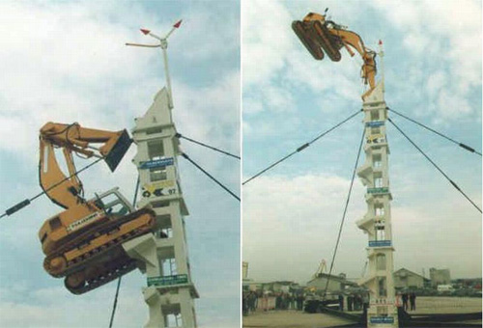
Actuation + Transmission
Excavators!
(hydraulics)

Slide 34
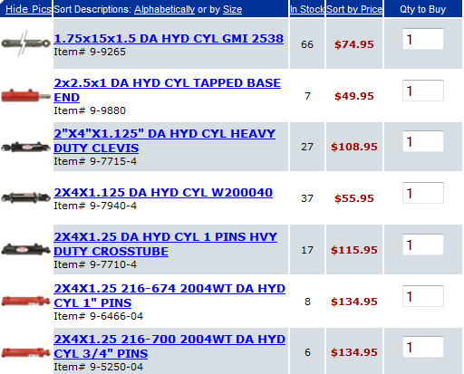
Actuation + Transmission
Hydraulics
Cheap
Available
Reliable

Slide 35
Powerplant + Energy Storage
Provide hydraulic power
Indoor/outdoor operation
Don’t have time to DIY
Need high reliability
Need safe fuel system

Slide 36
Actuation + Transmission
What vehicle powerplants provide this?

Slide 37
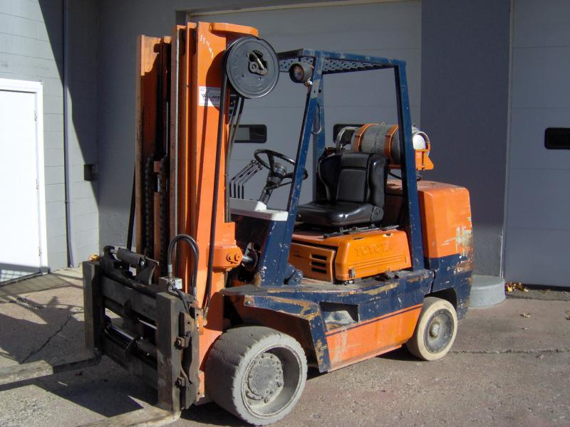
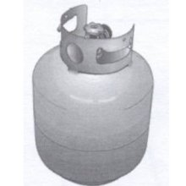
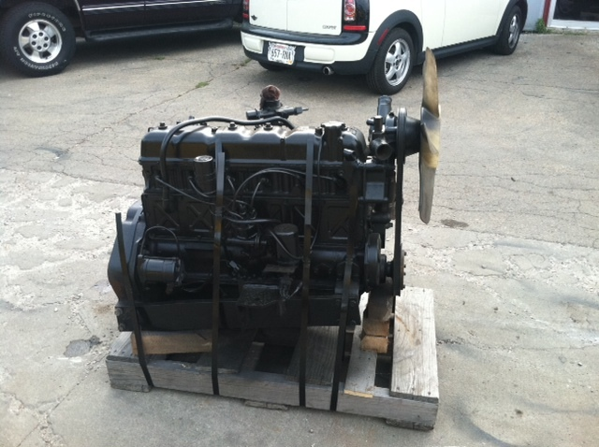
Powerplant + Energy Storage
Forklifts!
Propane engine clean to run inside
Fuel comes in rugged canisters
Engine and hydraulic pump are one unit
And we got one

Slide 38
Force-Controlled
We have 6 legs that look like excavators
Excavators are designed to dig into the ground
We need to know where the ground is in order to not destroy it
We need to not be incredibly rigid when we touch the ground
Force control and compliance is the answer

Slide 39
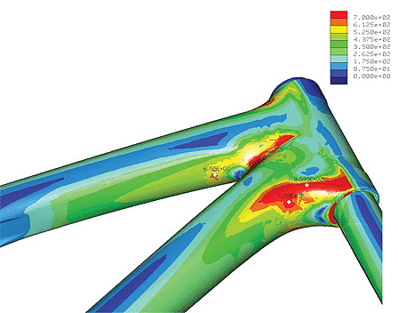
Structural
Steel weldments
Strong
Cheap
We can model them
We can fab them

Slide 40
Sensing + Electronics
At every joint, we need:
Position
Force
We have 18 joints spread out over ~20 feet of structure
We need to read them ~100 times / second

Slide 41
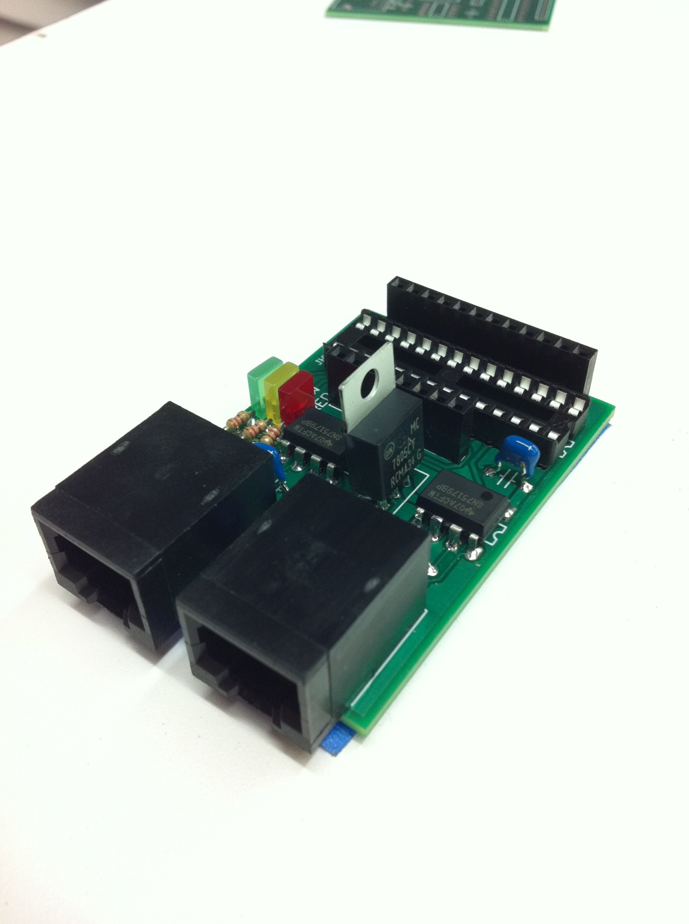
Sensing+Electronics
Modular nodes provides extensible digital + analog I/O

Slide 42
A note about “safety”…

Slide 43
“Safety”
You are a sack of meat, easily impaled by steel
Hydraulic systems can channel 100% of their available power to any one piston
Nothing like a 50 horsepower punch through the gut
A pinhole leak in 2,000 psi hydraulic systems can cut your hand off
Each leg of the full robot will weigh as much as you do
Propane explodes
Each cylinder can generate 10,000+ pounds of force

Slide 44
“Safety”
This robot will not move to you, it will move through you.

Slide 45
How are we building it?

Slide 46
Teams
Chassis/Powerplant Design Group
Leg Design Group
Electronics Group
Controls Group

Slide 47
Chassis/Powerplant
Primarily systems and mechanical design
Layout of cockpit (and passenger?)
Body shape and structure design
Engine and pump mounting, sensing and supporting systems
Trailer attachments

Slide 48
Leg Design
Primarily mechanical design
Design of mechanical leg structure
Selection of hydraulic actuators
Design of compliance element/force sensor
Foot system design

Slide 49
Electronics
Primarily electrical design
Design of sensing system
Design of actuator control system
Implementation of robust, large scale electronics system
Firmware development

Slide 50
Controls
Primarily programming/control systems
Design of inverse kinematic libraries
Design of several gaits
Tuning of control loops
User input design and control

Slide 51
Design Process

Slide 52
Design Exercises
Leg Cart
Mechanical Build
Electrical Build
Control
Single-Leg Simulation
Excavator Research & Design
HPU Research & Design
Hexapod Simulation
Quantitative Mechanical Design

Slide 53
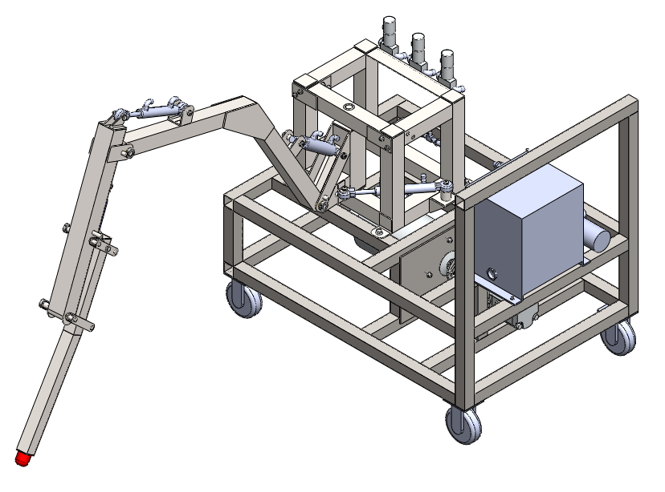
LegCart
Build a cart on “rails” with a single hydraulic leg and electric HPU
Mechanical team gets to assemble hydraulics and work with steel at half-scale
Electrical team gets to wire feedback devices and central processor
Controls team gets to figure out how to wrap a control loop and inverse kinematics around hydraulic hardware

Slide 54
Single-Leg Simulation
Controls team gets a simulator with a leg identical to the LegCart
Identical mechanical layout
Representative “electrical” inputs
Gets to prototype inverse kinematics, PID loops, and more in software before moving to hardware

Slide 55
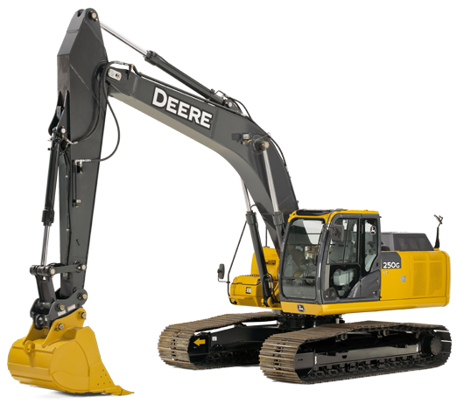
Excavator Research
Leg design team gets to research how excavators are designed
Excavators are hydraulic and designed to push into the ground; let’s figure out why they’re designed the way they are, and steal all the good ideas involved

Slide 56
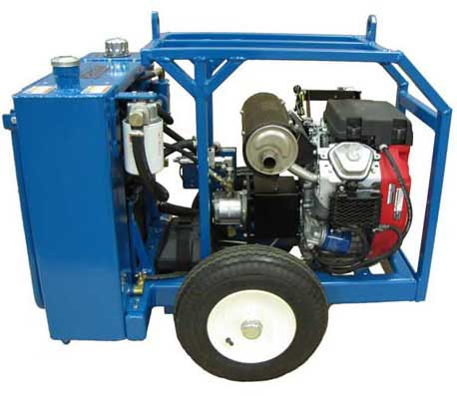
HPU Research
Chassis/Powerplant team gets to figure out how hydraulic power units are designed
Goal for the project is to develop a mobile, propane-powered hydraulic power unit that the rest of the robot attaches to
Team spends a bunch of time at Blake Courtney’s art car shop figuring out how to make the engine go

Slide 57
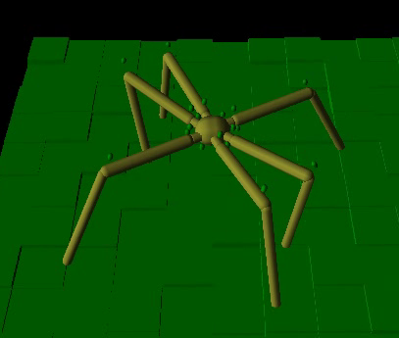
Hexapod Simulation
Once we have somewhat representative values for weights, link sizes, flow rates, pressures, etc., a representative hexapod simulation is made
Controls team develops gaits and places actuators in software in order to inform mechanical design

Slide 58
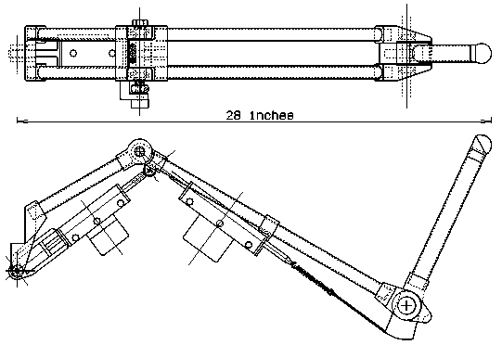
Quantitative Mechanical Design
Given the results of the simulation, select cylinders, cylinder placements, and leg designs that will create a mechanical plant as close to the simulation requirements as possible

Slide 59
And then we build. Forever. Or at least until August.

Slide 60
Questions?

Slide 61
Time for hydraulics!

